Slide 1
Visão por Computador
Filtros no Domínio das Frequências
Luís Paulo Peixoto dos Santos

Slide 2
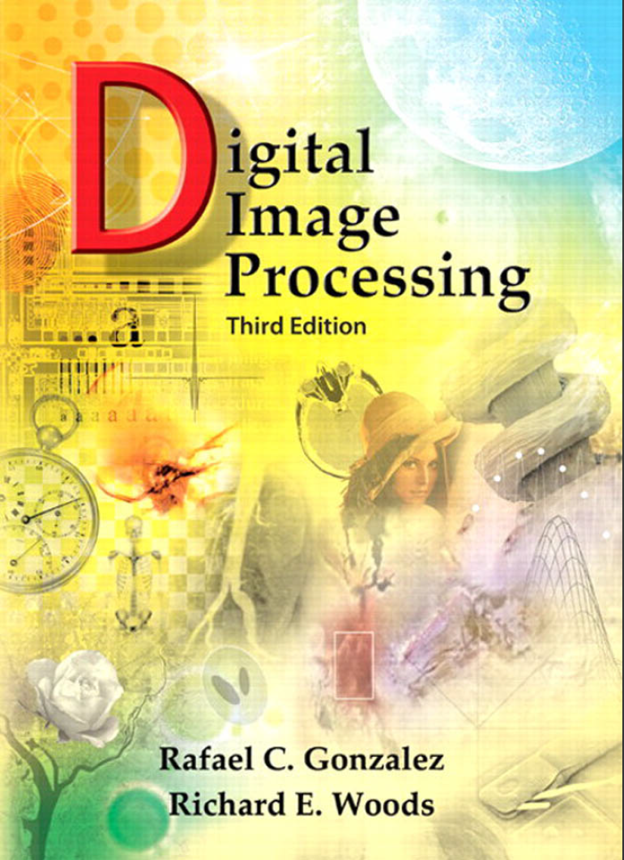
Bibliografia
© 2008 by Pearson Education, Inc.
Pearson Prentice Hall
Pearson Education, Inc.
Upper Saddle River, New Jersey 07458
ISBN 0-13-168728-x
https://www.imageprocessingplace.com/
Capítulo 4

Slide 3
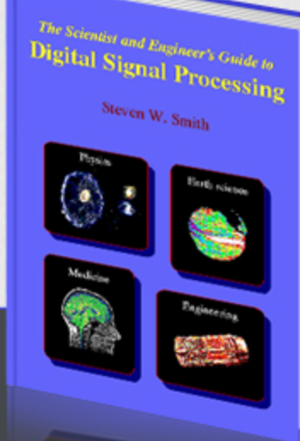
Bibliografia
© 1997 by California Technical Publishing
“The Scientist and Engineer Guide to Digital Signal Processing”
Steven W. Smith
https://www.dspguide.com/

Slide 4
What is frequency?
Frequency: “The number of times that a periodic function repeats the same sequence of values during a unit variation of the independent variable”
[https://www.merriam-webster.com/dictionary/frequency]

Slide 5
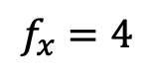
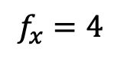
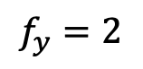
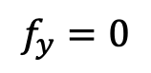
What is frequency?
Frequency: “The number of times that a periodic function repeats the same sequence of values during a unit variation of the independent variable”
[https://www.merriam-webster.com/dictionary/frequency]
$$f_{y}=0$$
$$f_{y}=2$$
$$f_{x}=4$$
$$f_{x}=4$$

Slide 6
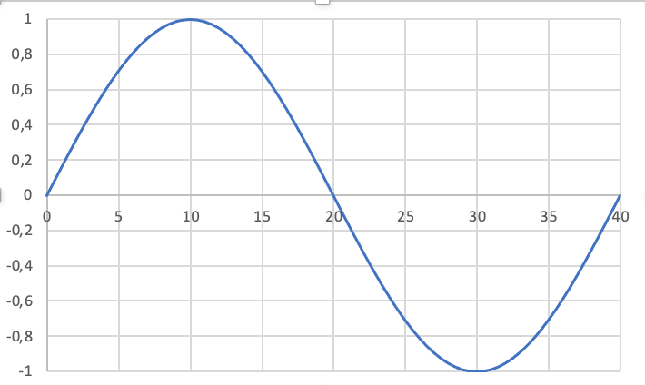
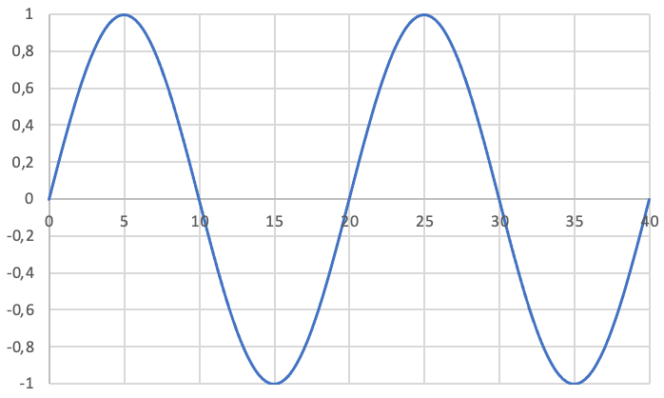
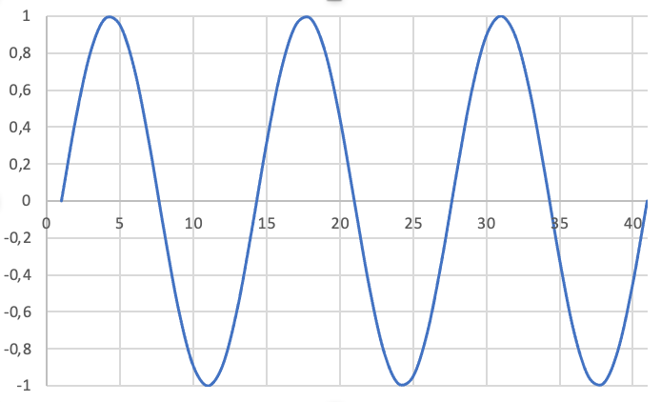
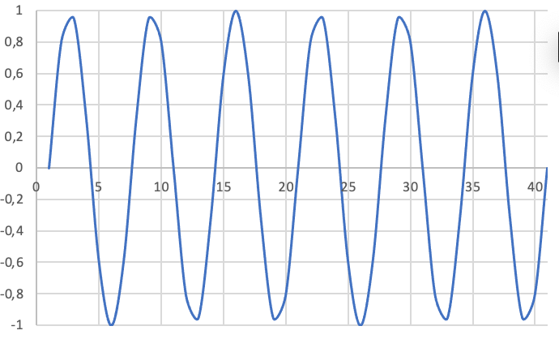
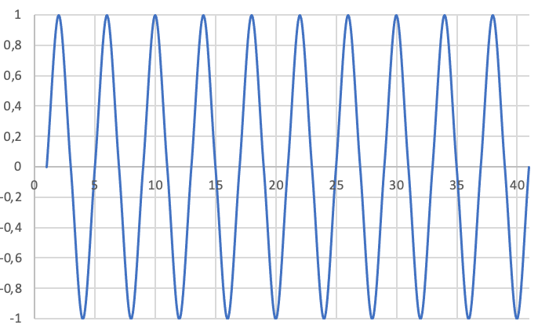
Fourier Decomposition
“Any periodic function can be expressed as the sum of sines and/or cosines of different frequencies, each multiplied by a different coefficient.”

Slide 7
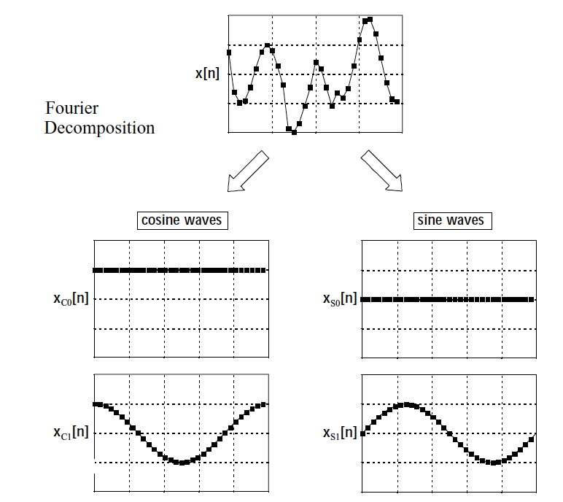
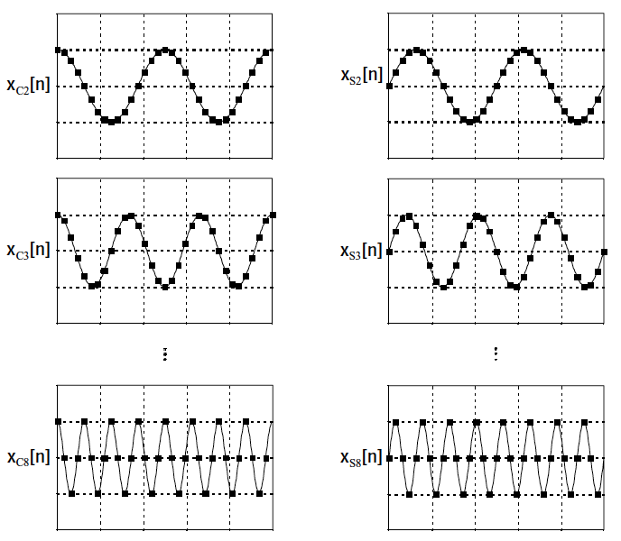
Fourier Decomposition

Slide 8
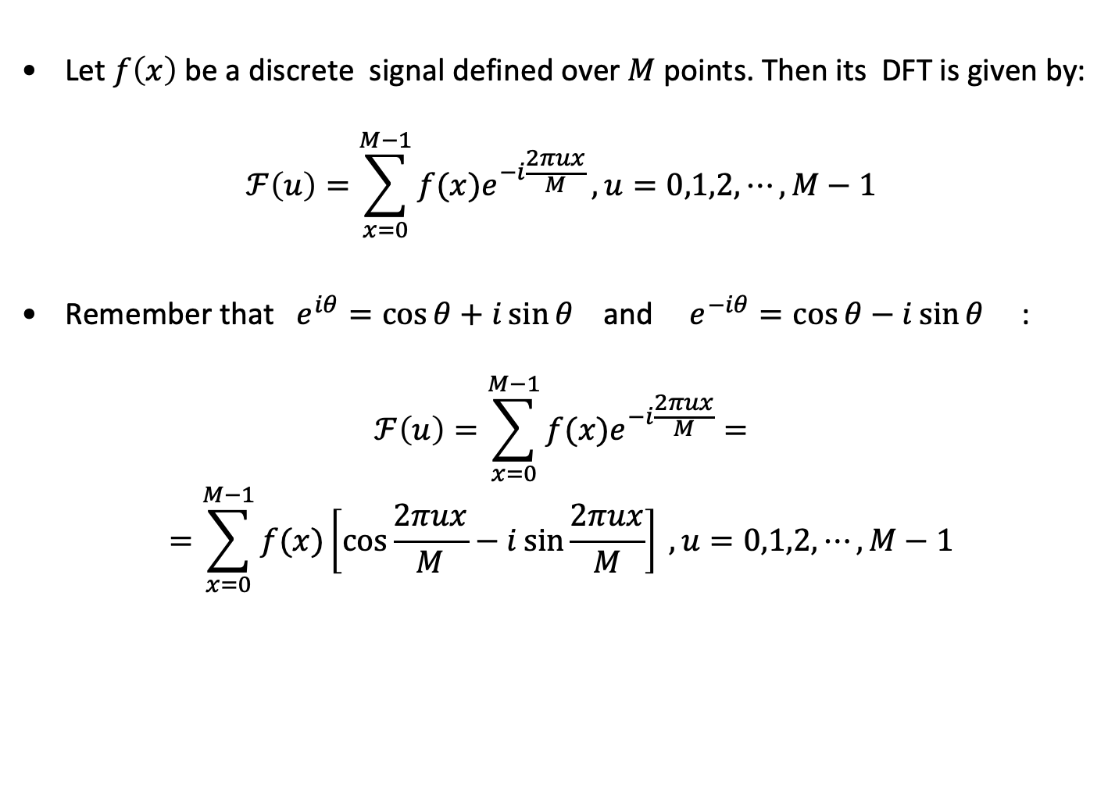
Discrete Fourier Transform (DFT)
Let $f\left(x\right)$ be a discrete signal defined over $M$ points. Then its DFT is given by:
$$ℱ\left(u\right)=\sum_{x=0}^{M−1}{f(x)e^{−i\frac{2πux}{M}}}, u=0,1,2,⋯,M−1$$
Remember that $e^{iθ}=\cos{θ}+i\sin{θ}$ and $e^{−iθ}=\cos{θ}−i\sin{θ}$ :
$$ℱ\left(u\right)=\sum_{x=0}^{M−1}{f(x)e^{−i\frac{2πux}{M}}}=$$
$$=\sum_{x=0}^{M−1}{f(x)\left[\cos{\frac{2πux}{M}}−i\sin{\frac{2πux}{M}}\right] }, u=0,1,2,⋯,M−1$$

Slide 9
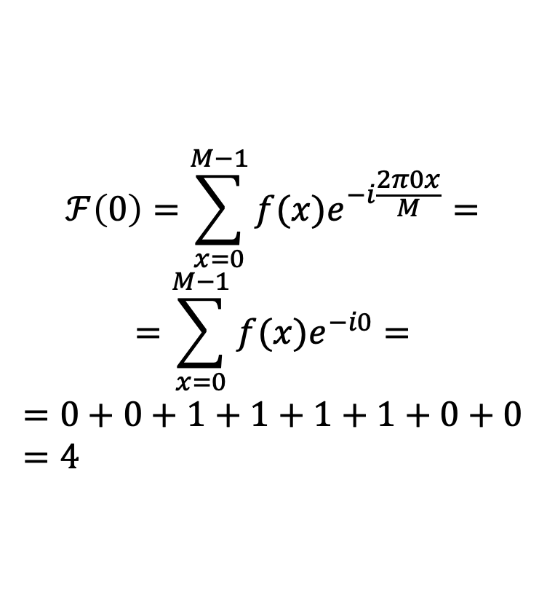
Discrete Fourier Transform (DFT)
x | f(x) | u
0 | 0. | 0
1 | 0. | 1
2 | 1. | 2
3 | 1. | 3
4 | 1. | 4
5 | 1. | 5
6 | 0. | 6
7 | 0. | 7
F(u)
4
-2.4+i
0
0.4-i
0
0.4+i
0
-2.4-i
$$ℱ\left(0\right)=\sum_{x=0}^{M−1}{f(x)e^{−i\frac{2π0x}{M}}}=$$
$$=\sum_{x=0}^{M−1}{f(x)e^{−i0}}=$$
$$=0+0+1+1+1+1+0+0=4$$

Slide 10
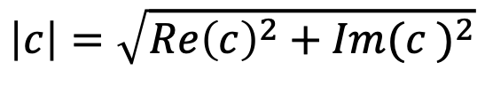

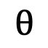
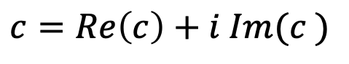

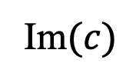
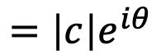
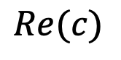
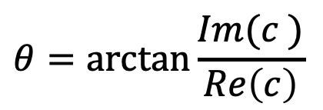
Magnitude + Phase Representation
$$c=Re\left(c\right)+i Im(c )$$
$$=\left|c\right|e^{iθ}$$
$$c$$
$$\left|c\right|=\sqrt{{Re\left(c\right)}^{2}+{Im(c )}^{2}}$$
Im$(c)$
$$\left|c\right|$$
$$θ$$
$$θ=\arctan{\frac{Im(c )}{Re\left(c\right)}}$$
$$Re(c)$$

Slide 11
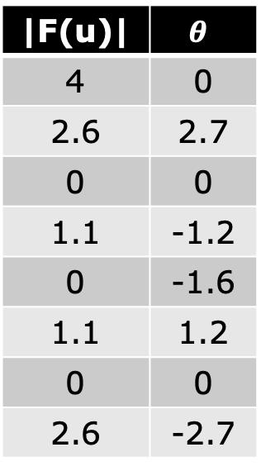
Discrete Fourier Transform (DFT)
x | f(x) | u
0 | 0. | 0
1 | 0. | 1
2 | 1. | 2
3 | 1. | 3
4 | 1. | 4
5 | 1. | 5
6 | 0. | 6
7 | 0. | 7
F(u)
4
-2.4+i
0
0.4-i
0
0.4+i
0
-2.4-i
|F(u)| | $$θ$$
4 | 0
2.6 | 2.7
0 | 0
1.1 | -1.2
0 | -1.6
1.1 | 1.2
0 | 0
2.6 | -2.7

Slide 12
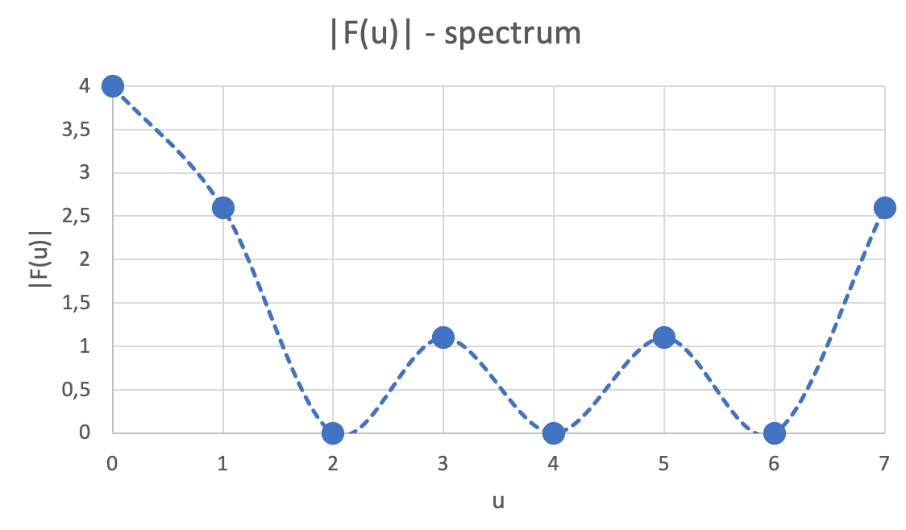
DFT – frequency spectrum
x | f(x) | u
0 | 0. | 0
1 | 0. | 1
2 | 1. | 2
3 | 1. | 3
4 | 1. | 4
5 | 1. | 5
6 | 0. | 6
7 | 0. | 7
|F(u)|
4
2.6
0
1.1
0
1.1
0
2.6
1st half of the cycle
2nd half of the cycle

Slide 13
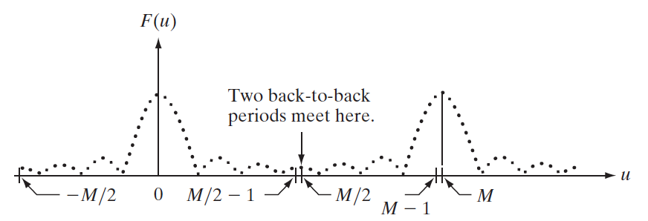
Shifting the DFT

Slide 14
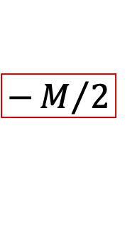
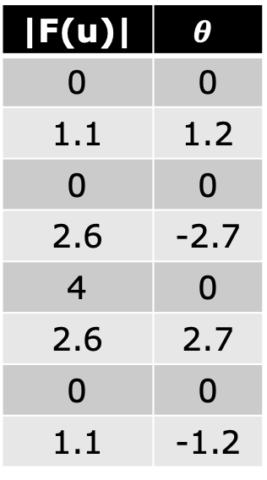
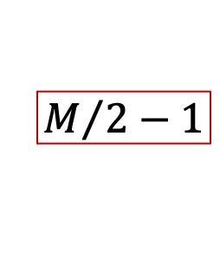
Shifting the DFT
$$−M/2$$
x | f(x) | u
0 | 0. | -4
1 | 0. | -3
2 | 1. | -2
3 | 1. | -1
4 | 1. | 0
5 | 1. | 1
6 | 0. | 2
7 | 0. | 3
F(u)
0
0.4+i
0
-2.4-i
4
-2.4+i
0
0.4-i
|F(u)| | $$θ$$
0 | 0
1.1 | 1.2
0 | 0
2.6 | -2.7
4 | 0
2.6 | 2.7
0 | 0
1.1 | -1.2
$$M/2−1$$

Slide 15
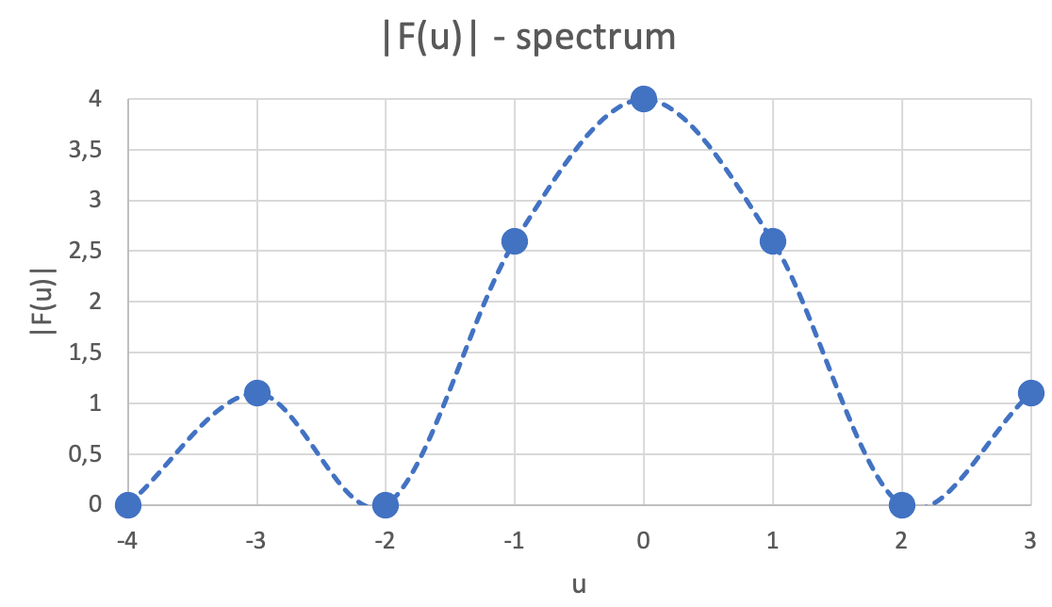
Shifting the DFT
x | f(x) | u
0 | 0. | -4
1 | 0. | -3
2 | 1. | -2
3 | 1. | -1
4 | 1. | 0
5 | 1. | 1
6 | 0. | 2
7 | 0. | 3
|F(u)|
0
1.1
0
2.6
4
2.6
0
1.1

Slide 16
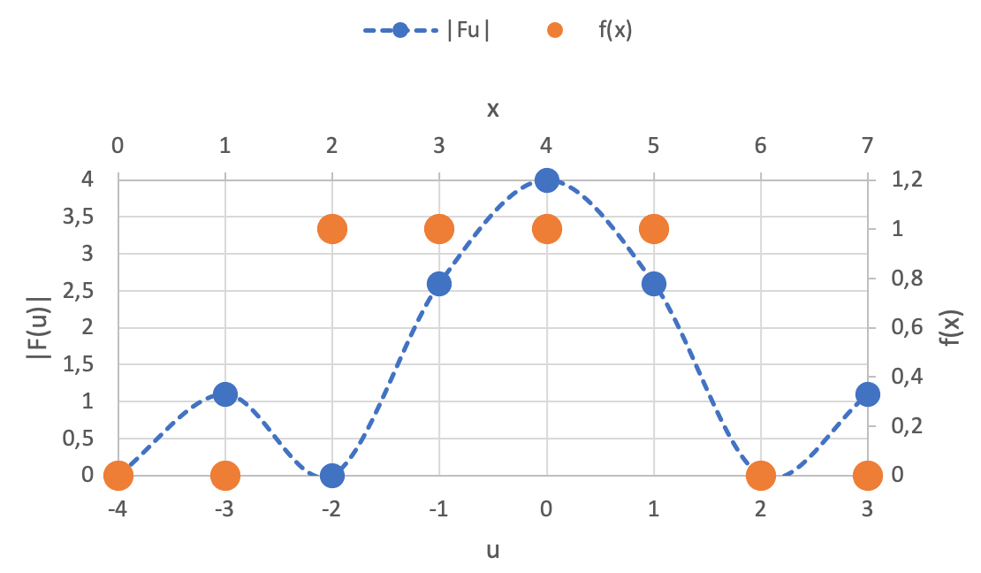



Analysing the DFT
x | f(x) | u
0 | 0. | -4
1 | 0. | -3
2 | 1. | -2
3 | 1. | -1
4 | 1. | 0
5 | 1. | 1
6 | 0. | 2
7 | 0. | 3
|F(u)|
0
1.1
0
2.6
4
2.6
0
1.1
$$W$$
$$a/W$$
$$2a/W$$

Slide 17
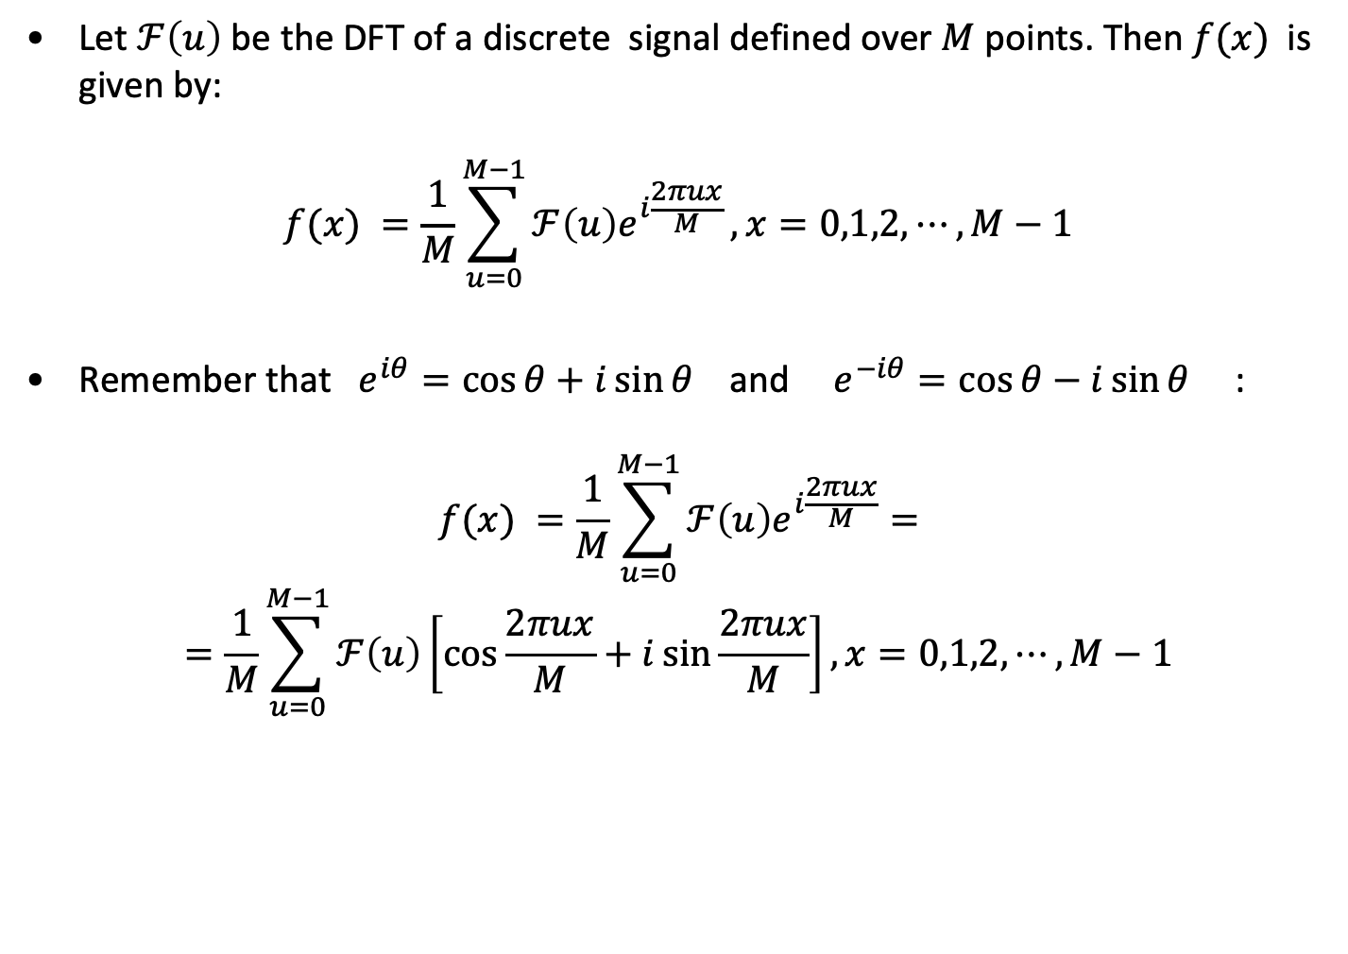
Inverse Discrete Fourier Transform (iDFT)
Let $ℱ\left(u\right)$ be the DFT of a discrete signal defined over $M$ points. Then $f(x)$is given by:
$$f(x) =\frac{1}{M}\sum_{u=0}^{M−1}{ℱ\left(u\right)e^{i\frac{2πux}{M}}}, x=0,1,2,⋯,M−1$$
Remember that $e^{iθ}=\cos{θ}+i\sin{θ}$ and $e^{−iθ}=\cos{θ}−i\sin{θ}$ :
$$f(x) =\frac{1}{M}\sum_{u=0}^{M−1}{ℱ\left(u\right)e^{i\frac{2πux}{M}}}=$$
$$=\frac{1}{M}\sum_{u=0}^{M−1}{ℱ\left(u\right)\left[\cos{\frac{2πux}{M}}+i\sin{\frac{2πux}{M}}\right]}, x=0,1,2,⋯,M−1$$

Slide 18
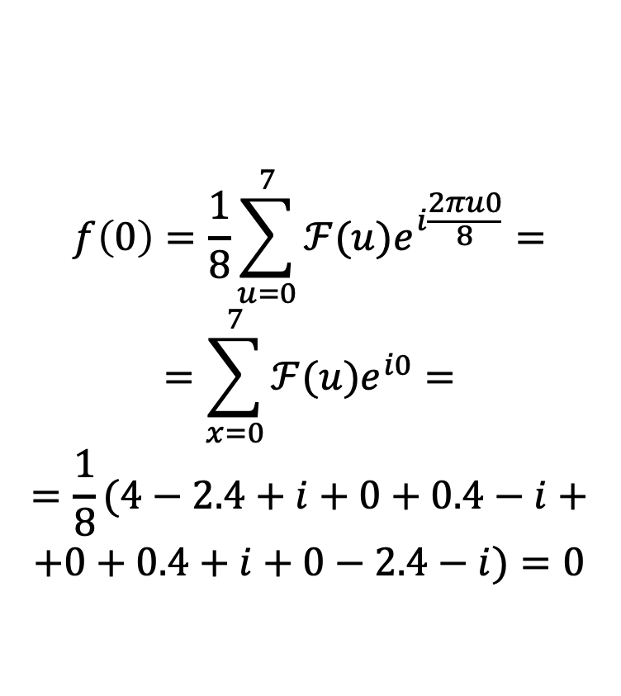
Inverse Discrete Fourier Transform (iDFT)
u | F(u) | x
0 | 4 | 0
1 | -2.4+i | 1
2 | 0 | 2
3 | 0.4-i | 3
4 | 0 | 4
5 | 0.4+i | 5
6 | 0 | 6
7 | -2.4-i | 7
f(x)
0.
0.
1.
1.
1.
1.
0.
0.
$$f\left(0\right)=\frac{1}{8}\sum_{u=0}^{7}{ℱ(u)e^{i\frac{2πu0}{8}}}=$$
$$=\sum_{x=0}^{7}{ℱ(u)e^{i0}}=$$
$$=\frac{1}{8}(4−2.4+i+0+0.4−i+$$
$$+0+0.4+i+0−2.4−i)=0$$

Slide 19
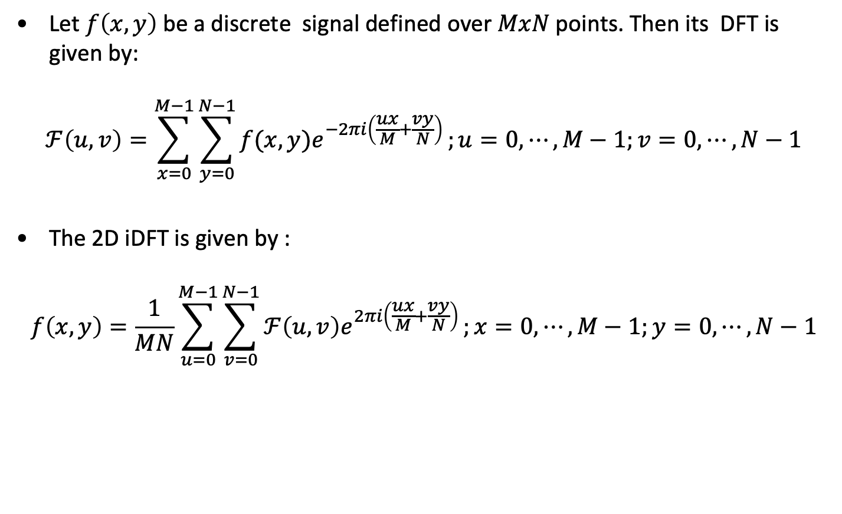
2D Discrete Fourier Transform
Let $f\left(x,y\right)$ be a discrete signal defined over $MxN$ points. Then its DFT is given by:
$$ℱ\left(u,v\right)=\sum_{x=0}^{M−1}{\sum_{y=0}^{N−1}{f(x,y)e^{−2πi\left(\frac{ux}{M}+\frac{vy}{N}\right)}}};u=0, ⋯,M−1;v=0, ⋯,N−1$$
The 2D iDFT is given by :
$$f\left(x,y\right)=\frac{1}{MN}\sum_{u=0}^{M−1}{\sum_{v=0}^{N−1}{ℱ\left(u,v\right)e^{2πi\left(\frac{ux}{M}+\frac{vy}{N}\right)}}};x=0, ⋯,M−1;y=0, ⋯,N−1$$

Slide 20
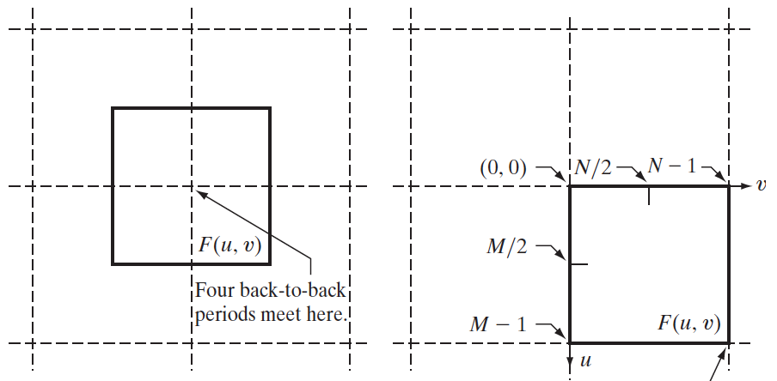
Shifting the 2D DFT

Slide 21
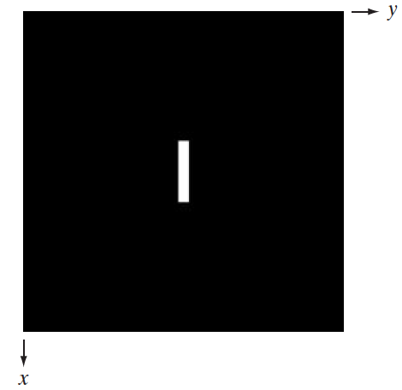
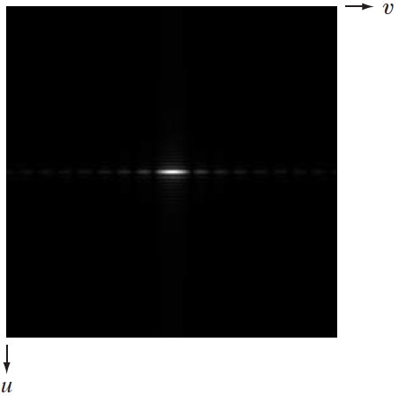
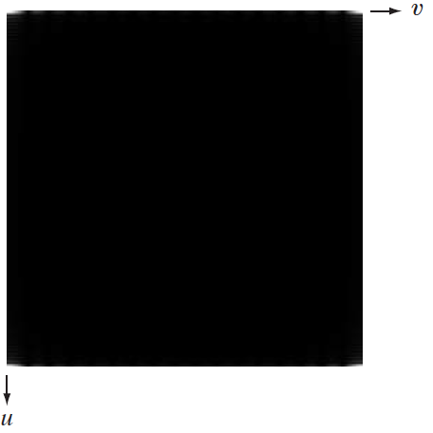
Shifting the 2D DFT
2D DFT Spectrum
Image
Centered 2D DFT

Slide 22
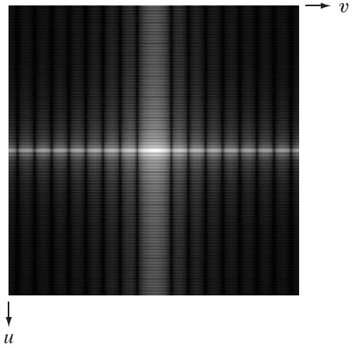
Scaling 2D DFT
Image
Log 2D DFT
Centered 2D DFT

Slide 23

DFT: Spectrum and Phase
Image
Spectrum
Phase

Slide 24

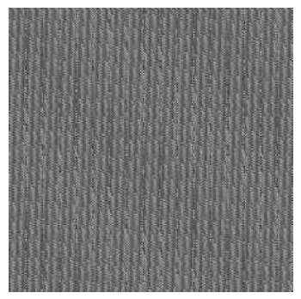
DFT of Translated Function
Image
Spectrum
Phase

Slide 25
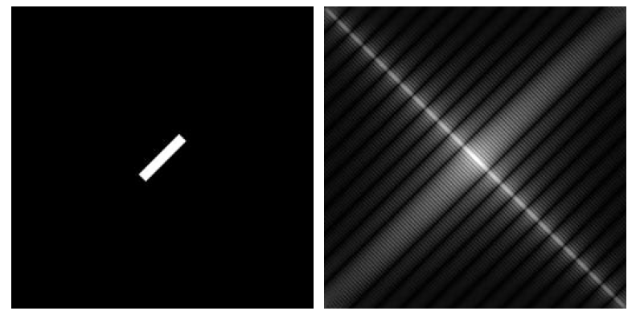
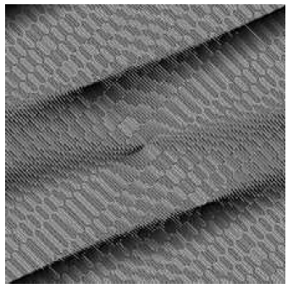
DFT of Rotated Function
Image
Spectrum
Phase

Slide 26
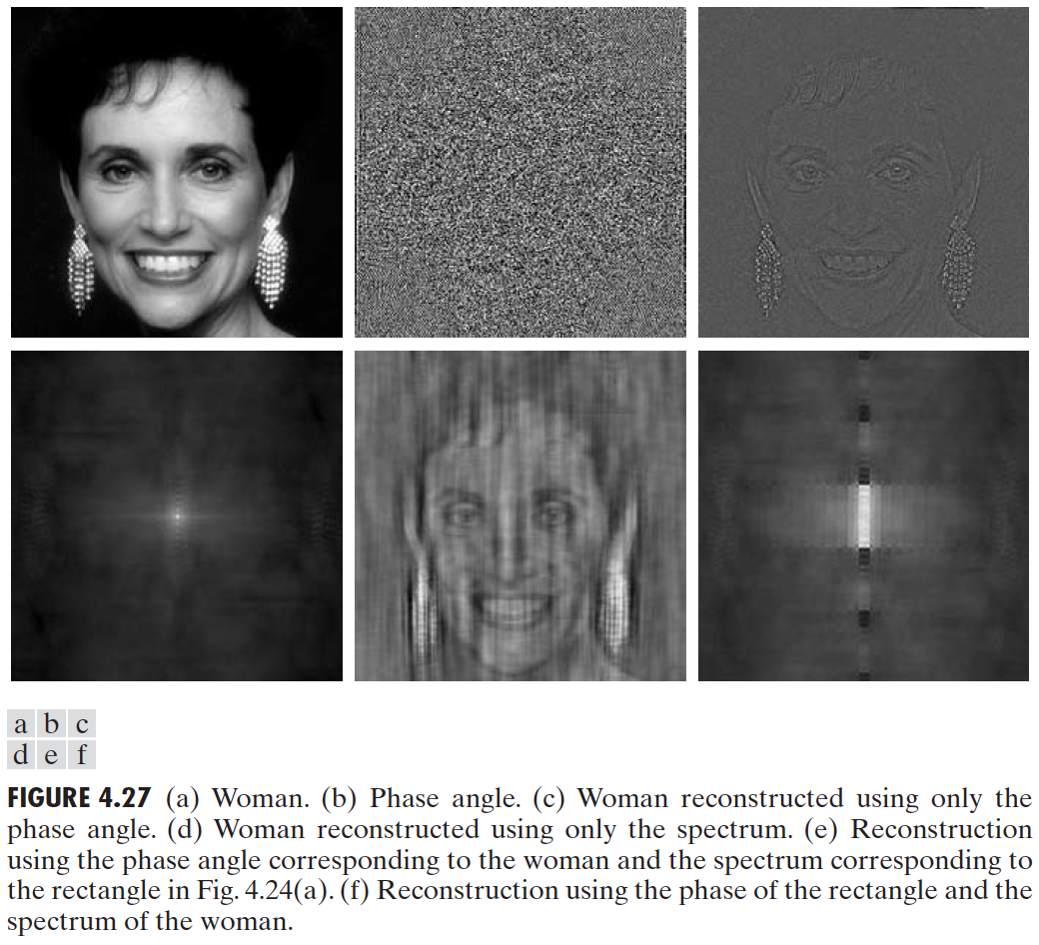
The relevance of phase

Slide 27

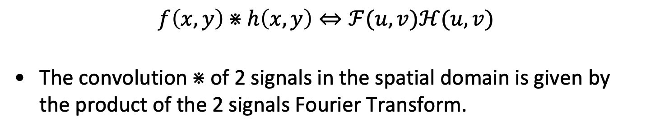
The Convolution Theorem
$$f\left(x,y\right)⋇h\left(x,y\right)⇔ℱ(u,v)ℋ(u,v)$$
The convolution $⋇$of 2 signals in the spatial domain is given by the product of the 2 signals Fourier Transform.
and conversely:
$$f\left(x,y\right)h\left(x,y\right)⇔ℱ(u,v)⋇ℋ(u,v)$$

Slide 28
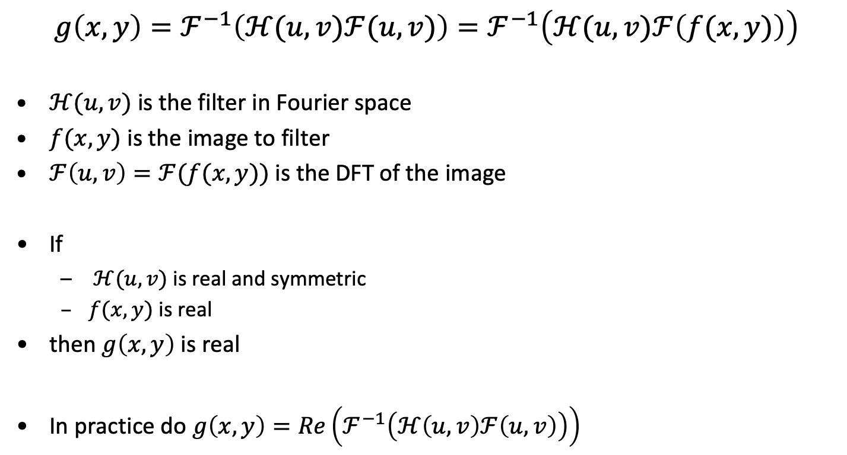
Filtering in the spectral space
$$g\left(x,y\right)=ℱ^{−1}\left(ℋ(u,v)ℱ(u,v)\right)=ℱ^{−1}\left(ℋ(u,v)ℱ\left(f(x,y)\right)\right)$$
$ℋ(u,v)$ is the filter in Fourier space
$f(x,y)$ is the image to filter
$ℱ\left(u,v\right)=ℱ(f(x,y))$ is the DFT of the image
If
$ℋ(u,v)$ is real and symmetric
$f(x,y)$ is real
then $g\left(x,y\right)$ is real
In practice do $g\left(x,y\right)=Re\left(ℱ^{−1}\left(ℋ\left(u,v\right)ℱ\left(u,v\right)\right)\right)$

Slide 29
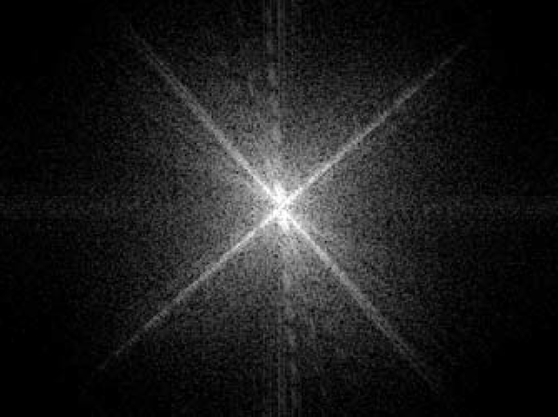
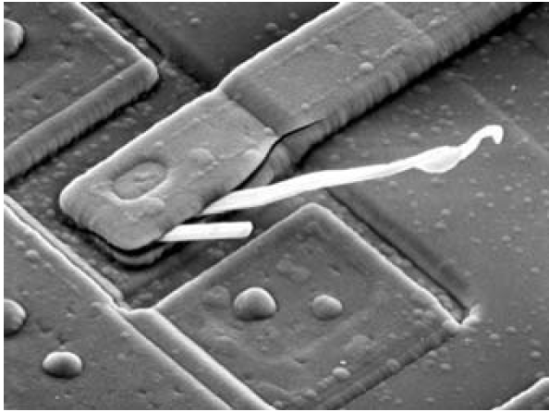
Filtering in the spectral space

Slide 30
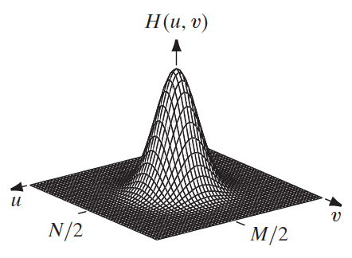
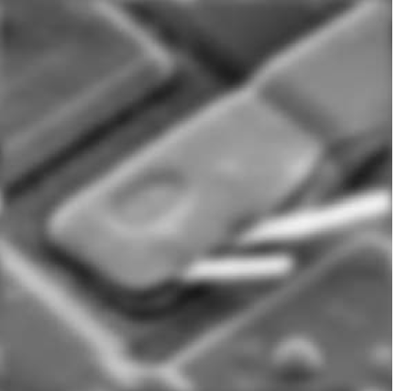
Low pass filtering

Slide 31
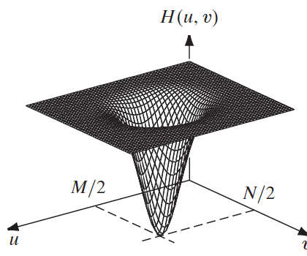
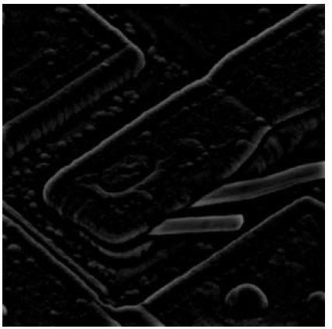
High pass filtering

Slide 32


Edge enhancement

Slide 33


Ideal Low Pass Filter (ILPF)
$$ℋ\left(u,v\right)=\left\{\begin{matrix}1 & if D(u,v)≤D_{0} \\ 0 & if D(u,v)>D_{0}\end{matrix}\right.$$
$$D\left(u,v\right)=\sqrt{{\left(u−\frac{M}{2}\right)}^{2}+{\left(v−\frac{N}{2}\right)}^{2}}$$

Slide 34




Ideal Low Pass Filter (ILPF)

Slide 35


Gaussian Low Pass Filter (GLPF)
$$ℋ\left(u,v\right)=e^{− {D^{2}(u,v)}/{{2D}_{0}^{2}}}$$
$$D\left(u,v\right)=D_{0}⇒ℋ\left(u,v\right)=0.607 max \left(ℋ\left(u,v\right)\right)$$
$$D\left(u,v\right)=\sqrt{{\left(u−\frac{M}{2}\right)}^{2}+{\left(v−\frac{N}{2}\right)}^{2}}$$

Slide 36


Gaussian Low Pass Filter (GLPF)

Slide 37



Spectral High Pass Filters
A high pass filter $ℋ_{HP}\left(u,v\right)$ can be obtained from a low pass $ℋ_{LP}\left(u,v\right)$:
$$ℋ_{HP}\left(u,v\right)=1−ℋ_{LP}\left(u,v\right)$$
IHPF
GHPF

Slide 38


Spectral High Pass Filters
IHPF D0=30
GHPF D0=30

Slide 39


Spectral Laplacian
$$ℒ\left(u,v\right)=−4π^{2}D^{2}(u,v)$$
For edge enhancement
$$ℋ\left(u,v\right)=1−αℒ\left(u,v\right)$$

Slide 40


Selective Filtering
Selective filters apply to specific bands or regions of the frequency space
Band reject Gaussian
Ideal notch filter
Note: the filters must be symmetric across the center to preserve phase

Slide 41
Notch Filter
A notch filter rejects (or passes) frequencies in a predefined neighborhood of a given point of the frequency rectangle
Ideal_notch (W,H, d0, u_k, v_k):
for (u=0 ; u<W ; u++) {
for (v=0 ; v<H ; v++) {
if ( (D(u, v, u_k, v_k, W, H) < d0) or
(Dm(u, v, u_k, v_k, W, H) < d0)) {
filter[u][v]=0;
} else {
filter[u][v]=1; }
} }
return filter;
}

Slide 42
Notch Filtering
Ideal_notch (W,H, 5, 20, 20)

Slide 43

Notch Filtering
Multiple filters are composited by multiplication
Ideal_notch (W,H, 5, 20, 20) * Ideal_notch (W,H, 5, -20, 20)

Slide 44





Notch Filtering

Slide 45


Notch Filtering
Can you do better?
Can you automatically detect the centers and/or radius of each notch filter?
Use the Fourier-NotchFilter.ipynb available on the elearning platform.

